Slide 1

Grad-Prep Workshop
Presented by Context Lab

Slide 2
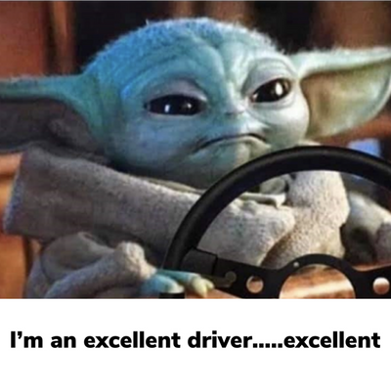


Enilda
Gabby
2nd year Ph.D. student
Air pollution and HCI for virtual interaction.
INTROS
1st year Ph.D. student
Visual cognition and driving
1

Slide 3

What is Graduate School?
Grad school is a lot more focused and specialized than college.
Classes are directed to a very specific field or area of study.
Graduate students are expected to not only absorb information and gain knowledge but also to conduct their own research (mainly PhDs).
The main difference: Undergrad (you gain knowledge); Graduate School (you produce knowledge).
2

Slide 4

Should YOU go to Graduate School?
Committed to a field that requires a graduate degree to progress.
You want to become an expert within a specific topic in your chosen field.
You want to produce your own work. (e.g., research, patents!)
You are passionate about a certain area in your field and want to learn more.
3

Slide 5
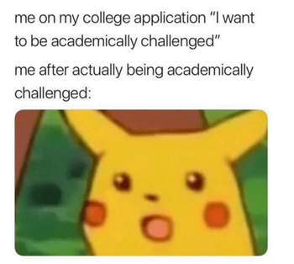
Should YOU go to Graduate School?
Graduate school is very specialized.
It is a lot of money, and some programs are a 2–6-year commitment.
Graduate school is a lot of work – need motivation/ reason to keep you going.
Gap years are ok! It leads to a time of self-discovery and figuring out what you want.
The opportunity to get more research experience (e.g., in your current lab or seeking new opportunities.
4

Slide 6




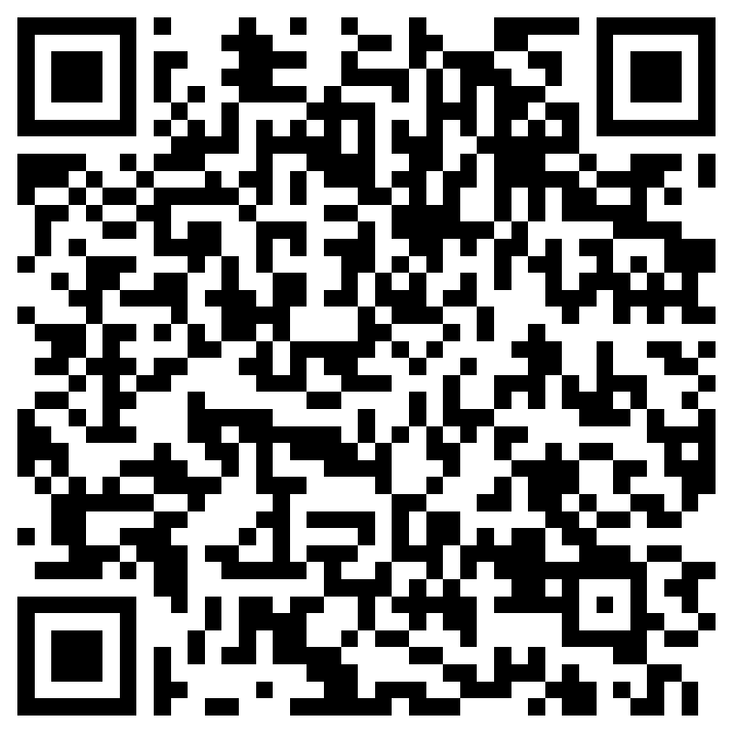
POLL
5

Slide 7

Choosing a school or program
Organization of your school search will make the application and decision process so much easier (especially if applying to multiple programs).
Everyone’s choice of program and school is very personal.
Think about it- am I willing to move and live in this place for 2-6 years?
Advisors mean everything if you are applying to a research-focused program!
6

Slide 8
Can be terminal or en route.
More career-oriented.
Can culminate into a thesis.
Comparatively less competitive admissions.
Takes on average 2-3 years.
Most likely limited in funding opportunities.
Masters
vs.
Highest academic degree.
Heavily research based, you'll graduate a field expert.
Extensive milestones, culminates into a dissertation.
Highly competitve admissions.
Takes on average 5-7 years.
Fully funded.
PhD
7

Slide 9

Application Materials
Application
Online; paper sent via mail.
Fill out information about you and your experiences.
Florida public universities application cost $30 non-refundable.
Some schools application I applied for cost up to $120 (Gabby).
Transcripts
UCF Transcripts cost $15 each without a service charge .
Note: if you are a transfer student, you have to send transcripts from the college you attended prior to UCF.
GRE scores
Cost $ to submit but it's free of charge if you enter the school at the testing center.
Letters of recommendation
2-3 recommenders
Resume/CV
Statements
Personal statement
Diversity statement (some schools include this)
8

Slide 10
Not another standardized test
GRE General Test
Similar to SAT – assess competence in math, reading, and writing.
Check the program website or reach out to the program specialist to find out if it is required.
Programs may have cutoff or recommended/average scores.
Don’t let this discourage you from applying.
Post-2020 wave of dropping GRE in the graduate admission process.
UCF does not require GRE scores!
GRE Subject Tests
Some programs require a psychology subject test, which was designed to assess knowledge and skill. level within the psychology academic discipline.
GRE Standardized test by Educational Testing Service (ETS) to measure academic readiness for graduate school.
9

Slide 11

GRE Prep
Practice! Practice! Practice!
There are study books/tests/flashcards/online classes/ tutors available
Official Guide to GRE General Test by ETS (https://www.ets.org/content/dam/ets-org/pdfs/gre/sample-question-overview.pdf)
Kaplan, Princeton, Magoosh, Greg Matt (Youtube)
GRE Prep is expensive $$$
Libraries have prep books available
YouTube has a lot of practice
Quizlet is great for vocabulary
Ask someone like me who was planning a potential bonfire with GRE prep material if they are donating/selling material (Gabby)
10

Slide 12

Searching programs
p.s. Google is your bestie!
Q: How many programs should I apply to?
A: That is up to you! Keep in mind that FIT is what matters most. Gabby applied to 6, Enilda applied to 2, and we've heard of people applying up to 13.
Q: What else should I think about?
A: Remember, applications can be costly and they take a lot of time to complete! Check your programs to see if they offer any financial assistance with their applications.
11

Slide 13

Finding an advisor (PhD programs)
Should have similar/ overlapping research interests for the following reasons:
Appling to a PhD program is like applying to work for a job with a specific person
You are going to be in their laboratory doing research with them or for them
They will be your mentor and ensure that you are meeting your program milestones
We recommend having at least 2 potential advisors in mind if the program requires a thesis or dissertation.
How should I reach out to a potential advisor?
Email!
Read some of their research articles (e.g., on Google Scholar) to have an idea of what they are currently working on
Introduce yourself and share your research interest
Show interest in their work! Ask questions.
Mention how their work relates to your interest
Ask if they considering taking a new grad student
Include CV or Resume in your email
12

Slide 14
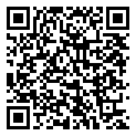
Apps: Planning & Management
The best app organization system is the one that you use consistently!
We used spreadsheets (see an example from our workshop repo below).
There are different app timelines you can use but choose one that works with your needs.
Tips
Plan early!
Reach out to recommenders early.
Give yourself enough time to prep and take the GRE.
It is never too late to start but be mindful of deadlines and of everyone’s time!
Timeline from the Yale Office of Career Strategy
13

Slide 15
Funding: Scholarships/Fellowships/Grants
What is a scholarship?
Financial assistance to undergraduate and graduate students.
You do not have to repay a scholarship.
Generally tax-free
What is a fellowship?
Generally, offers more money than scholarships
Often a set amount of aid for semester(s) or year(s)
Often provides benefit of covering tuition costs and provide monthly stipend.
Considered taxable income.
What is a grant?
A grant is like a scholarship.
These mainly come from government agencies.
Requires proof of financial need.
Project specific.
14

Slide 16

Funding: Graduate Assistantships
What is a graduate assistantship?
Salaried student employment for grad students.
Set number of hours per week to work (often 20 hours).
Compensation
Monthly living stipend.
Tuition waiver.
Types of assistantship positions:
Graduate teaching assistants.
Graduate research assistants.
15

Slide 17

Career and Grad School Resources @ UCF
There are official and ‘unofficial’ resources (e.g., us, Dr. Roque, or any of your mentors on campus)
Experiential Learning
Career Services
Office of Undergraduate Research
What do they provide?
Resume and CV editing and consultations
Workshops for everything grad school related: general prep, admissions essays, etc.
Panels with current grad students
Career/Grad fairs
Interview prep
Links to funding options
16

Slide 18

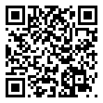
Here's a QR link to a resource repository we created to help you along your grad admissions journey!
Here we have:
This slide deck.
An e-Guide with a personal statement sample, CV sample, links, and more!
Spreadsheet templates.
This repository will be updated as more resources are acquired!
17
CONTEXT LAB

Slide 19
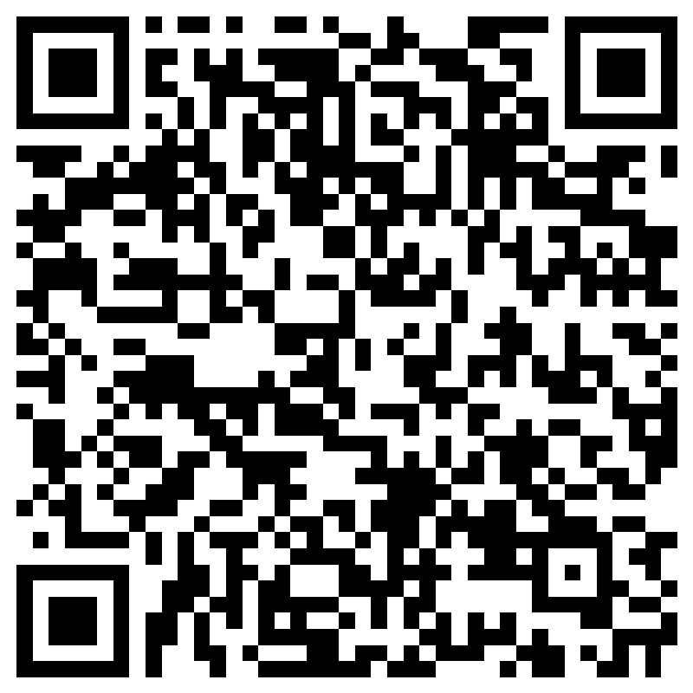
Survey Feedback
18
CONTEXT LAB

